Slide 1

Time Series Analysis with Python
Aug 2020
The AI Institute

Slide 2
Course Curriculum
NumPy Overview
Pandas Overview
Data Visualization
Time Series with Pandas
Time Series with Statsmodels
Different Forecasting models in Time Series Analysis
Facebook’s Prophet Library
Capstone Project

Slide 3
Goals of this course
Understand how to use Python to work with time series data
Use Pandas and Statsmodels to visualize time series data
Be able to use a wide variety of forecasting techniques on time series data

Slide 4
NumPy Basics
Quick section on NumPy basics and how to manipulate data with it:
NumPy Arrays
NumPy Indexing and Selection
NumPy Operations
NumPy Exercises

Slide 5

Pandas Basics
Pandas is used for data analysis and data exploration.
We will learn how to use this library since its fundamental to handling our data source

Slide 6
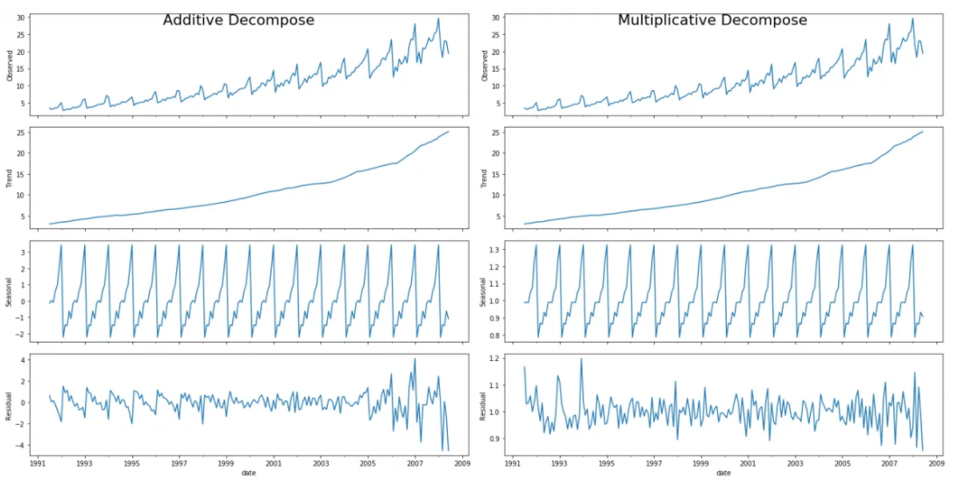
Pandas Visualization
Pandas also comes with a lot of built in visualization tools which we will explore to quickly view time series data on a chart!

Slide 7
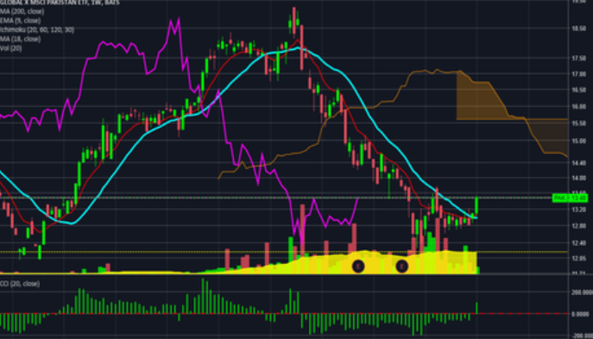
Time Series with Pandas
After reviewing the Pandas fundamentals, we will focus on specialized tools within pandas specifically designed to work with time stamped data.

Slide 8
Time series analysis with statsmodels
Statsmodels is a statistical library for python that contains and entire library of time series statistical analysis tools.
This section will be an introduction to use Statsmodels for basic time series analysis.

Slide 9
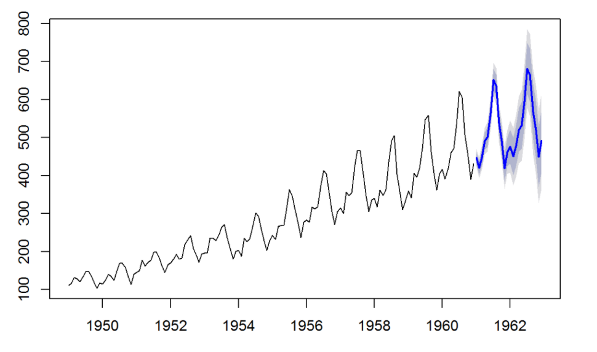
Time Series Forecasting models
In this section we will dive deep into various forecasting models based on ARIMA (AutoRegressive Integrated Moving Average)

Slide 10

FACEBOOK’S PROPHET LIBRARY
Prophet is a procedure for forecasting time series data based on an additive model where non-linear trends are fit with yearly, weekly, and daily seasonality, plus holiday effects. It works best with time series that have strong seasonal effects and several seasons of historical data. Prophet is robust to missing data and shifts in the trend, and typically handles outliers well.

Slide 11

Capstone project
In this section we will complete our learning process with applying all the skills that we learned to the real word data to have hands on experience with the time series data.

Slide 12
NumPy library
NumPy is a powerful linear algebra library for Python. What makes it so important is that almost all libraries in the PyData ecosystem (pandas, SciPy, Scikit-learn, etc.) rely on NumPy as one of their main building blocks.
NumPy is also incredibly fast, as it has bindings to C libraries. For more info on why you would want to use arrays instead of lists, check out this great StackOverflow post.
We will only review the basics of the NumPy in this section.

Slide 13
NumPy Arrays
NumPy arrays are the main way we will use NumPy throughout the course. NumPy arrays essentially come in two flavors: vectors and matrices. Vectors are strictly 1-dimensional (1D) arrays and matrices are 2D (but you should note a matrix can still have only one row or one column).
Here are the list of activities in NumPy arrays that we are going to work on:
Crating NumPy arrays from Python list
Built in method for arrays generation
Arange
Zeros and ones
Linspace
Eye
Random number arrays:
Rand
Randn
Randint
Seed
Array attribute and methods
Reshape
Min, Max, Argmax, Argmin
Shape
dtype

Slide 14
NumPy indexing and selection
In this section we will discuss how to select elements or groups of elements from an array:
Bracket indexing and selection
Broadcasting
Indexing a 2D array (Matrices)
Conditional selection

Slide 15

NumPy Operations
NumPy comes with many universal array functions, which are essentially just mathematical operations that can be applied across the array. Let's show some common ones:
Arithmetic
Universal functions
Summary Statistics on Arrays
Axis Logic

Slide 16
Introduction to Pandas
In this section of the course we will learn how to use pandas for data analysis. You can think of pandas as an extremely powerful version of Excel, with a lot more features. In this section of the course, you should go through the notebooks in this order:
Series
DataFrames
Missing Data
GroupBy
Merging, Joining and Concatenating
Operations
Data Input and Output

Slide 17
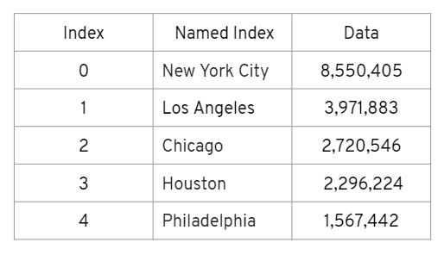
Series
A series is the basic building block of Pandas.
It holds an array of information organized by an Index.
NumPy array has data with an index.
Series is built on top of a NumPy array and can have a Named Index.

Slide 18
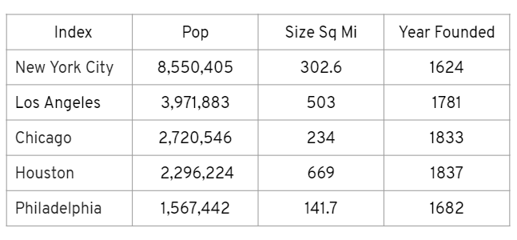
Dataframes
A DataFrame is simply multiple series that share the same index!
It is essentially a tabular data storage format.
DataFrame has multiple columns
Each of these columns is a Series object

Slide 19

MISSING DATA
Sometimes data will be missing from your original source, yet many forecasting methods can’t work with a missing data point!
There is no “correct” approach, since each case will be different.
Fortunately, by their very nature, many sources of time series data rarely have missing information.
Missing Data has only 3 options:
Keep the missing data (NaN), if the forecasting method can handle it.
Fill in the missing data with some value (best estimated guess).
Drop the missing data (the entire row including the timestamp).

Slide 20
groupby
Often you may want to perform an analysis based off the value of a specific column, meaning you want to group together other columns based off another.
In order to do this, we must perform 3 steps:
Split
Apply
Combine
Pandas does all of this for this with a simple method call: .groupby()

Slide 21
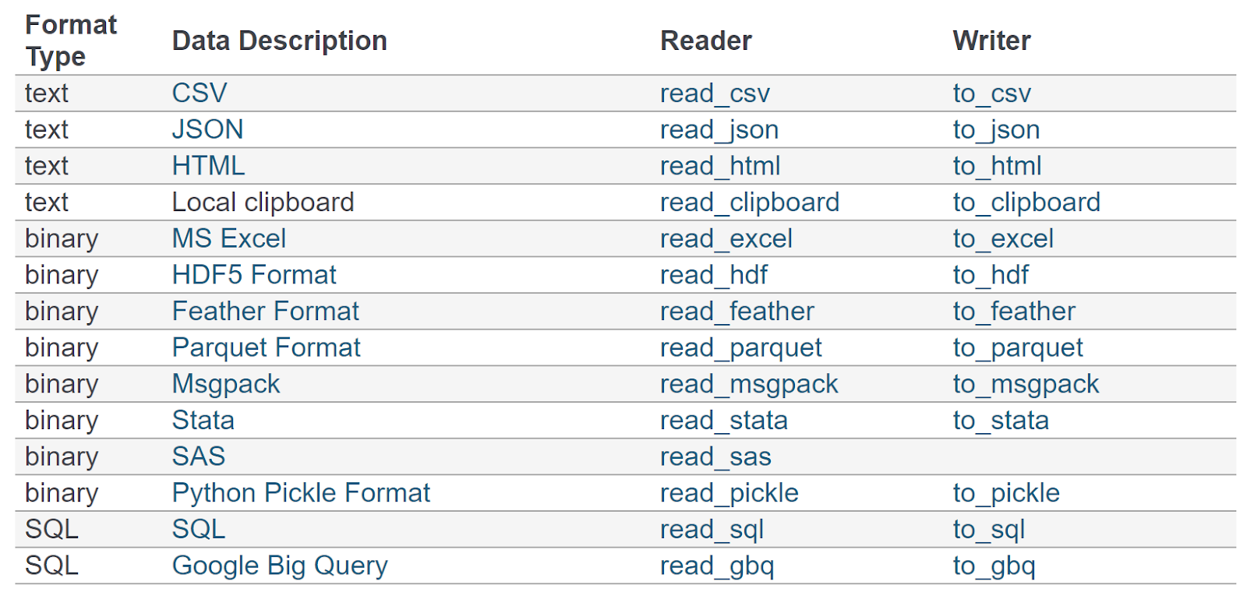
Data input and output
Pandas can read a variety of tabular data formats.
Keep in mind, for this course, we will provide all the data for you in CSV files.

Slide 22

Pandas Visualization
Section Goals:
Learn various plot types available with pandas
Learn basics of customizing plots
Exercises
Pandas has built-in capabilities to visualize data held inside of a Series or DataFrame.
These capabilities are built directly off a library called Matplotlib.
Pandas makes creating plots simple one line segments of code.

Slide 23

Time series with python
In this section we will discuss:
DateTime Index Basics
Time Resampling
Time Shifting
Rolling and Expanding
Time Series Visualization and project exercise

Slide 24
StatsModels
Statsmodels is a Python module that provides classes and functions for the estimation of many different statistical models, as well as for conducting statistical tests, and statistical data exploration.
Section Goals:
Time Series Data components
ETS (Error-Trend-Seasonality) models
SMA (Simple Moving Average) model
EWMA (Exponentially Weighted Moving Average) model
Holt-Winter seasonal model

Slide 25
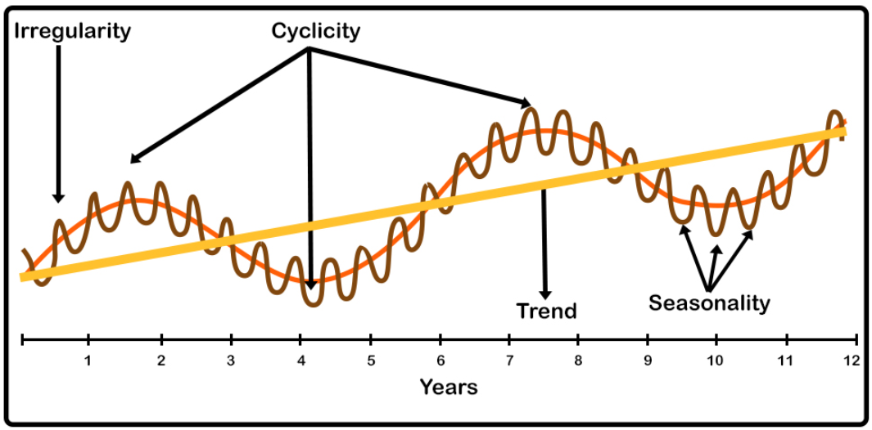
Time Series Components
Trend (Upward, Downward, Horizontal or stationary)
Seasonality (Repeating trend over similar time stamp and it could be monthly, quarterly, annually)
Cyclicity (Trends with no set of repetition)
Irregularity (Short term fluctuation)

Slide 26
How we can decompose the time series data into the components?
Hodrick-Prescott filter: It can split the time series data into a trend and cyclical components. (We cannot see the seasonality component with this filter)
When analyzing quarterly data the default lambda value is 1600.
When analyzing monthly data the default lambda value is 129600.
When analyzing annual data the default lambda value is 1600.
Statsmodels provide a better way to filter out the time series components out of our data which can help us to capture the seasonality trend as well.

Slide 27
How we can decompose the time series data into the components?
ETS (Error-Trend-Seasonality) models:
Exponential Smoothing
Trend methods models
ETS decomposition (We are going to focus on it in this section)
ETS models will take each of these terms for smoothing the model, and may add them, multiply them, or even just leave some of them out.
Visualizing the data based off its ETS decomposition is a good way to understand data behavior.

Slide 28
There are two types of models available for ETS decomposition
Additive model: when it seems that the trend is more linear, and seasonality and trend components seems to be constant we are going to use additive model.
Multiplicative model: this model is more appropriate when we can see the increase or decrease at a nonlinear trend in our database.

Slide 29
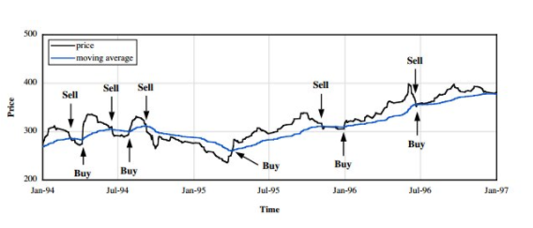
Moving Average theory
SMA (Simple Moving Average): In simple moving average the entire model will be constrained to the same window size. All variables have the same weight.
EWMA Exponential Weighted Moving Average): In this model we could have most recent data be weighted more than older data. Also we can eliminate the lag effect from SMA by putting more weight on most recent data.
We only apply one smoothing factor (Alpha) in EWMA which only can handle the irregularity component of time series data. This is failed to account for other contributing factors like trend and seasonality.

Slide 30

Holt-Winter model
In this model we are going to apply all tree factors correspond to the time series data components for having smoother model.
(Alpha) this factor will take care of short-term fluctuation (irregulating and cyclic components)
(Beta) this factor will take care of trend effect into our data
(Gamma) this factor will handle the seasonality impact into our data
We have two variation for this method that can differ in the nature of the seasonal components:
Additive model: Linear trend (seasonal variation is constant through the series)
Multiplicative model: Exponential trend (Seasonal variation are changing proportional to the level of series)

Slide 31
General time series forecasting models
Section Overview:
Introduction to Forecasting models into time series data
ACF and PACF plots
AutoRegression –AR
Descriptive Statistics and Tests
Choosing ARMA orders
ARIMA based models
Forecasting Procedure:
Choose a Model
Split data into train and test sets
Fit model on training set
Evaluate model on test set
Re-fit model on entire data set
Forecast for future data

Slide 32
ACF plot (AutoCorrelation Function Plot): An autocorrelation plot (also known as a Correlogram ) shows the correlation of the series with itself, lagged by x time units.
Imagine we had some sales data. We can compare the standard sales data against the sales data shifted by 1 time step. This answers the question, “How correlated are today’s sales to yesterday’s sales?
PACF - Partial AutoCorrelation Function Plot: The ACF describes the autocorrelation between an observation and another observation at a prior time step that includes direct and indirect dependence.

Slide 33
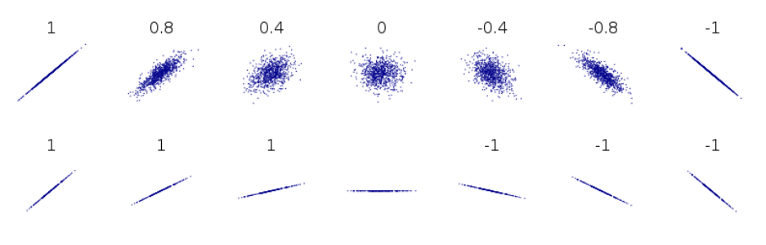
Correlation
To understand these plots, we first need to understand correlation:
Correlation is a measure of the strength of the linear relationship between two variables.
The closer the correlation is to +1, the stronger the positive linear relationship
The closer the correlation is to -1, the stronger the negative linear relationship.
And the closer the correlation is to zero, the weaker the linear relationship or association.

Slide 34
Why these two plots are important
These two plots can help choose order parameters for ARIMA based models. Later on, we will see that it is usually much easier to perform a grid search of the parameter values, rather than attempt to read plots directly.

Slide 35
ARIMA MODELS
ARIMA (Auto Regression Moving Average models)
It is important to understand that ARIMA is not capable of perfectly predicting any time series data.
Beginner students often want to directly apply ARIMA to time series data that is not directly a function of time, such as stock data.
ARIMA performs very well when working with a time series where the data is directly related to the time stamp, such as the airline passenger data set.

Slide 36
Arimas models
ARIMA (Autoregressive Integrated Moving Averages)
Non-seasonal ARIMA
Seasonal ARIMA (SARIMA)
Also understanding SARIMA with exogenous variables, such as SARIMAX.

Slide 37
Parts of arima
Parts of ARIMA model
AR (p): Autoregression
A regression model that utilizes the dependent relationship between a current observation and observation over previous period.

Slide 38
Parts of arima
Parts of ARIMA model
I (d): Integrated.
Differencing of observations (subtracting an observation from an observation at the previous time step) in order to make the time series stationary.

Slide 39
Parts of arima
MA (q): Moving Average.
A model that uses the dependency between an observation and a residual error from a moving average model applied to lagged observation.

Slide 40
STATIONARITY vs Non-Stationary Data
ARIMA models are applied in some cases where data show evidence of non-stationarity, where an initial differencing step (corresponding to the "integrated" part of the model) can be applied one or more times to eliminate the non-stationarity.
Stationary vs Non-Stationary Data
To effectively use ARIMA, we need to understand Stationarity in our data.
So what makes a data set Stationary?
A Stationary series has constant mean and variance over time.

Slide 41
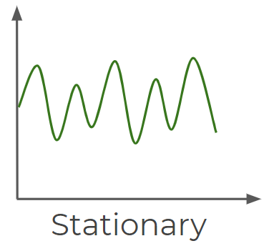
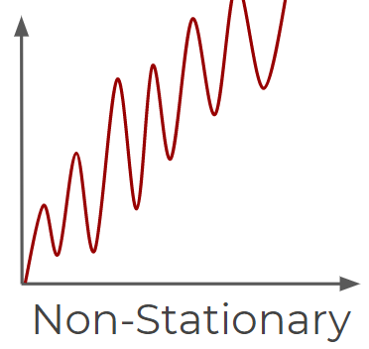
STATIONARITY vs Non-Stationary Data
A Stationary data set will allow our model to predict that the mean and variance will be the same in future periods.
Mean needs to be constant
Variance should not be a function of time.

Slide 42
How to check stationarity of the data
There are also mathematical tests you can use to test for stationarity in your data.
A common one is the Augmented Dickey–Fuller test (we will see how to use this with python stats models.

